Slide 1
요금 및 혜택

Slide 2
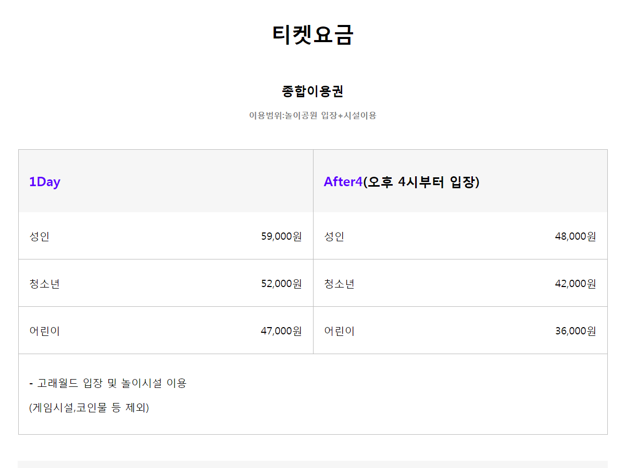
td:nth-child(2n){border-right : }

Slide 3
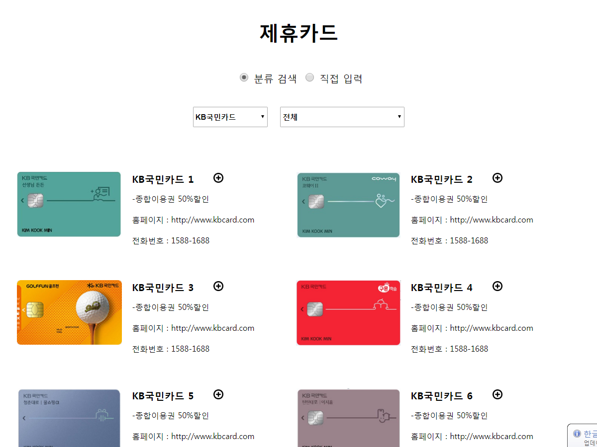
<body>
<input type="radio" name="div" checked="checked" onclick=“cList('0');"/>분류 검색
<input type="radio" name="div" onclick=“cList('1');"/>직접 입력
<div id="selectCard">
<div id="searchCard" style="display:none;">
</body>
<script>
function cList(cr) {
var obj1 = document.getElementById("selectCard"); //
var obj2 = document.getElementById("searchCard"); //
if( cr == "0" ) {
obj1.style.display = "block";
obj2.style.display = "none";
} else {
obj1.style.display = "none";
obj2.style.display = "block";
}
}
</script>

Slide 4
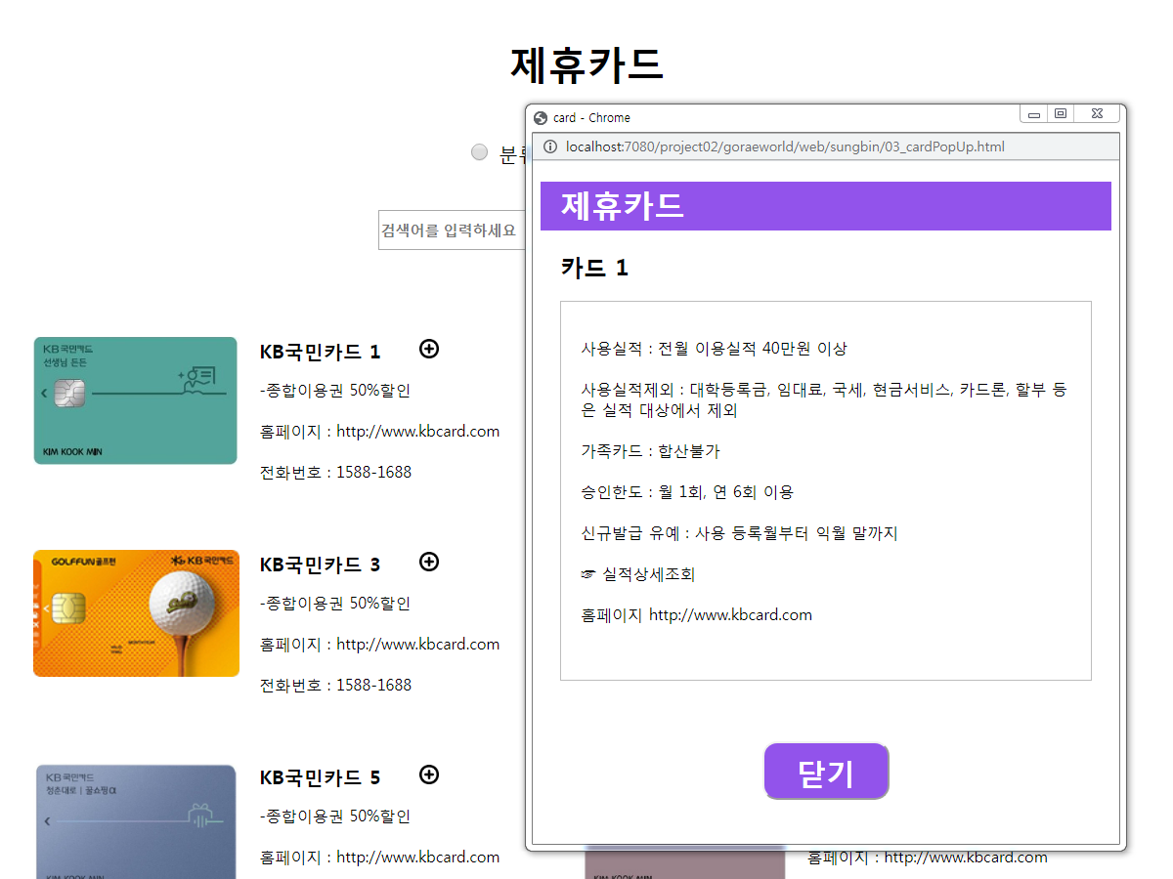
<a href=“#” onclick="window.open(this.href,'_blank','width=600,height=700');
<img></a>

Slide 5
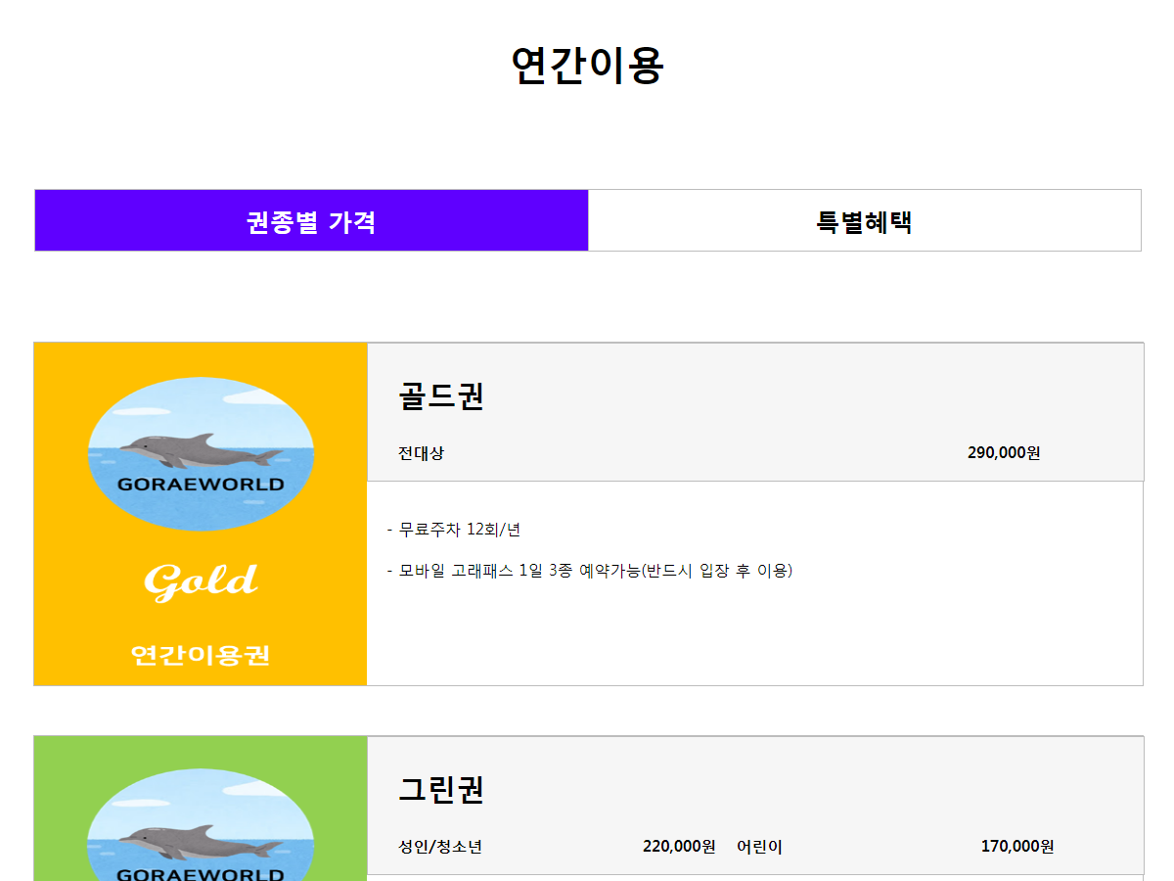

Slide 6
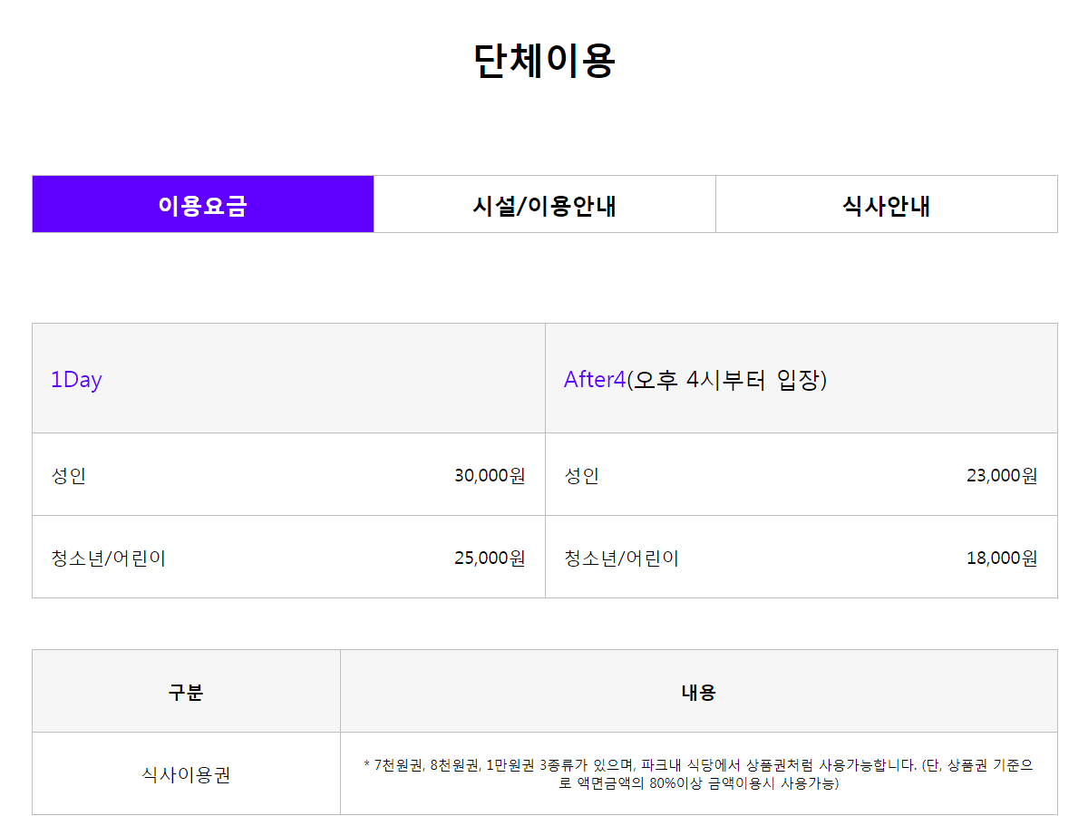

Slide 7
예매

Slide 8
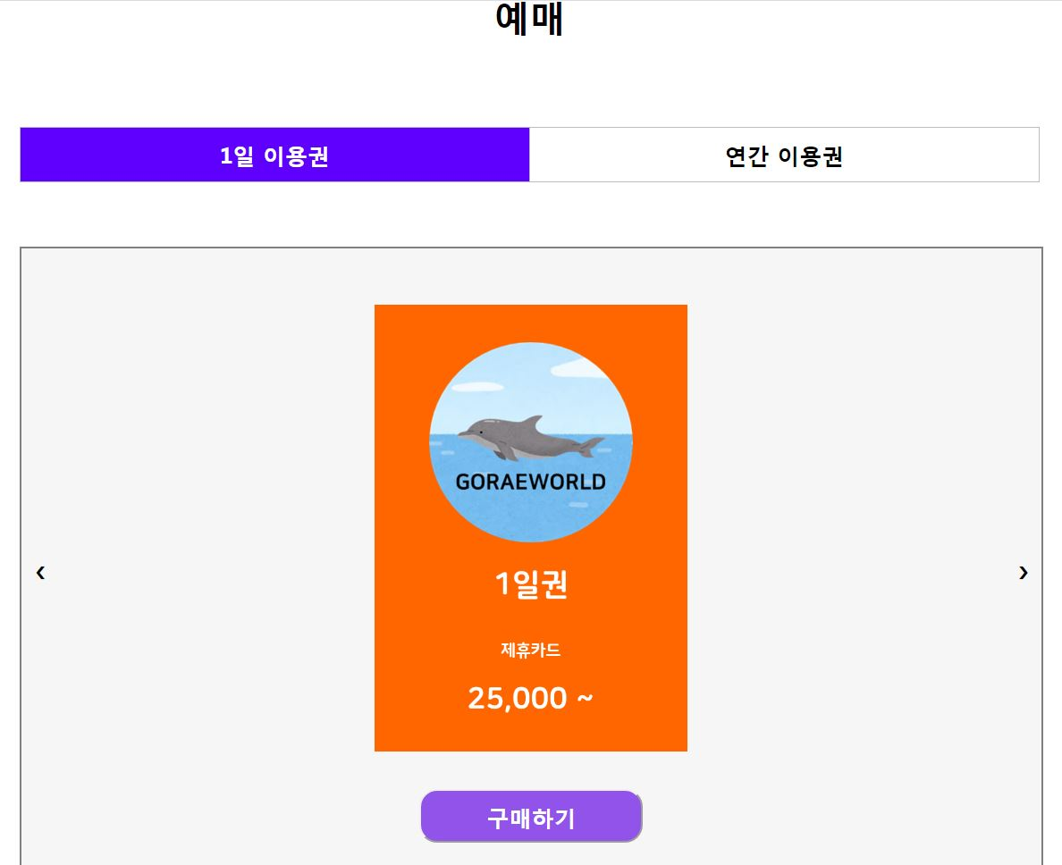

Slide 9
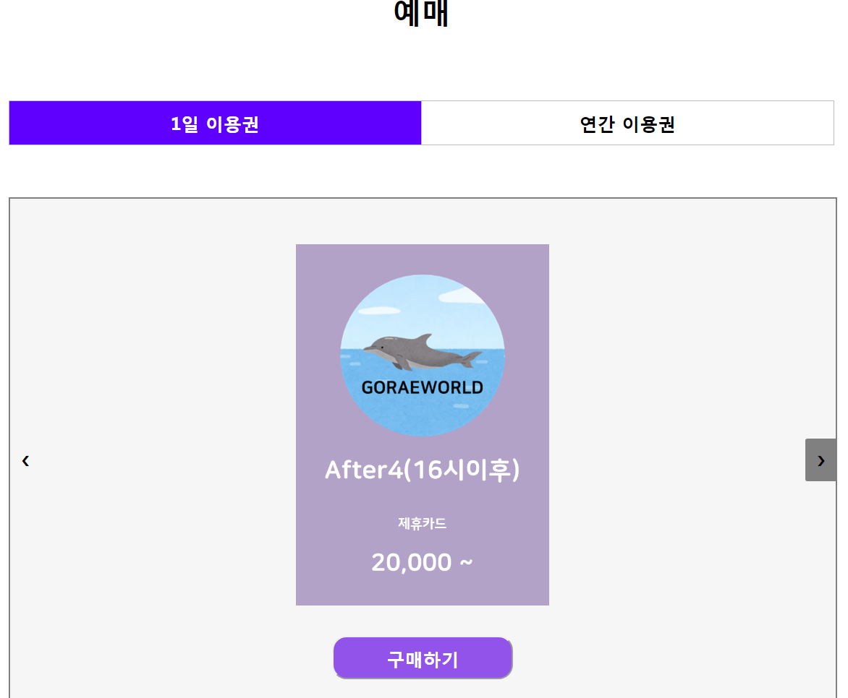
<body>
<div id="ticket“ background:url(/이미지 경로 1/);
background-size:cover;></div>
<a class="prev" onclick="prevSlides()">&#10094;</a> // 버튼
<a class="next" onclick="nextSlides()">&#10095;</a>
</div>
</body>
<script>
var currentticket = 1;
function prevSlides() {
if(currentticket == 1){
ticket.style.background="url(/이미지경로 2/)"; // prev 클릭
currentticket = 2;
}else if(currentticket == 2){
ticket.style.background="url(/이미지경로 1/)";
currentticket = 1;
}
ticket.style.backgroundSize = "cover";
}
</script>

Slide 10
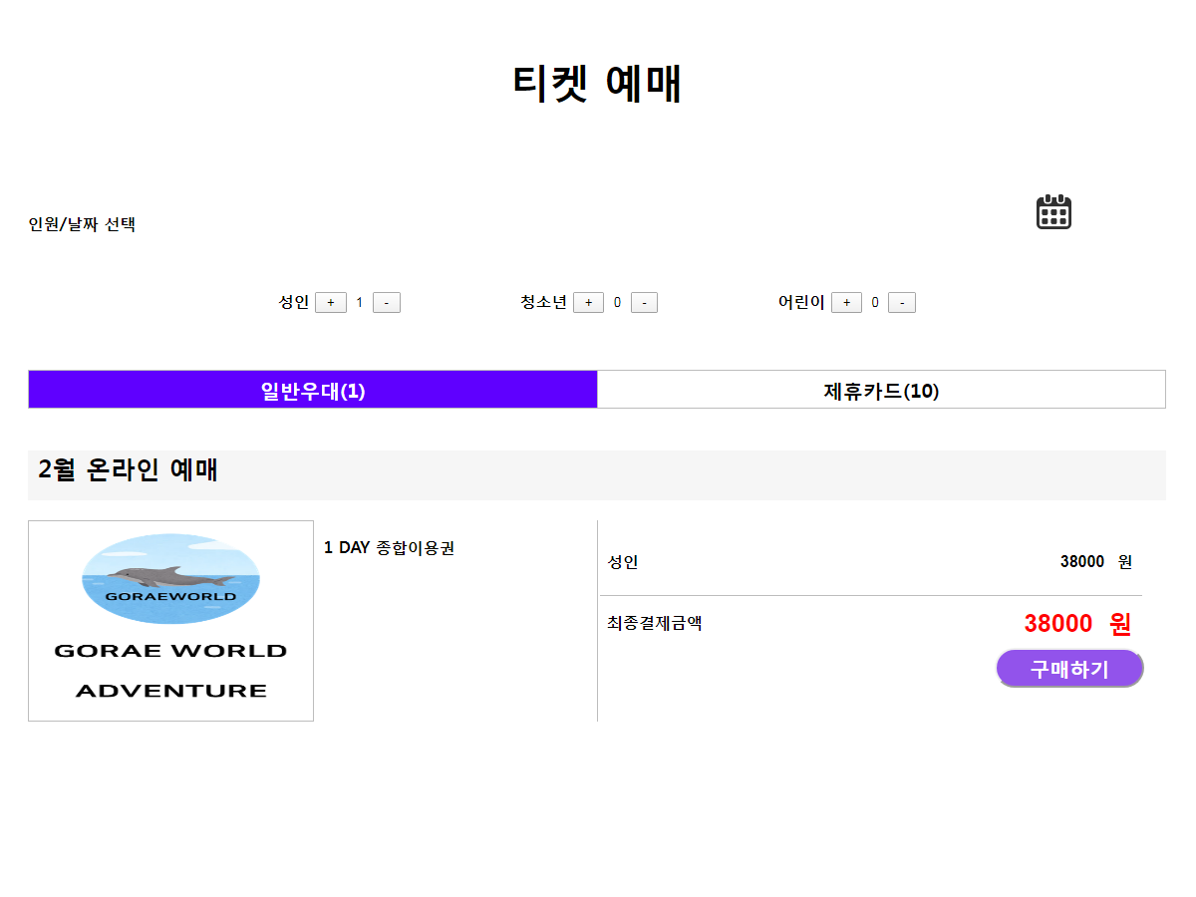

Slide 11
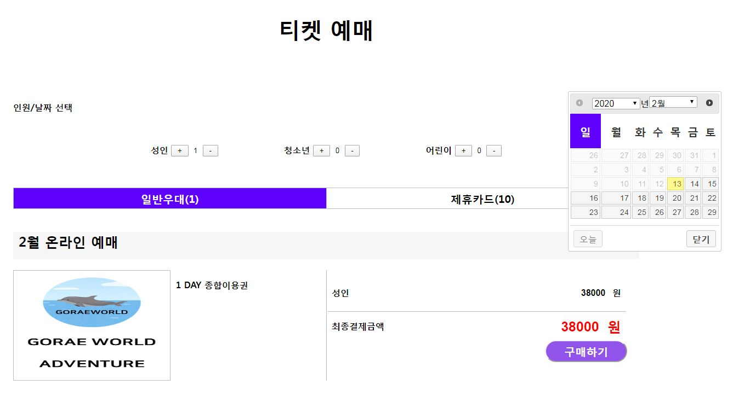
<body>
<input type="text" id="datepicker" >
</body>
<script src="https://code.jquery.com/jquery-3.4.1.min.js"></script>
<script src="https://code.jquery.com/ui/1.12.1/jquery-ui.min.js"></script>
<script src="https://cdnjs.cloudflare.com/ajax/libs/jqueryui/1.9.2/i18n/jquery.ui.datepicker-ko.min.js"></script>
<script type="text/javascript" src="https://cdnjs.cloudflare.com/ajax/libs/moment.js/2.24.0/moment.min.js"></script>
<script>
$( function() {
$( "#datepicker" ).datepicker({
옵션
});
} );
</script>

Slide 12
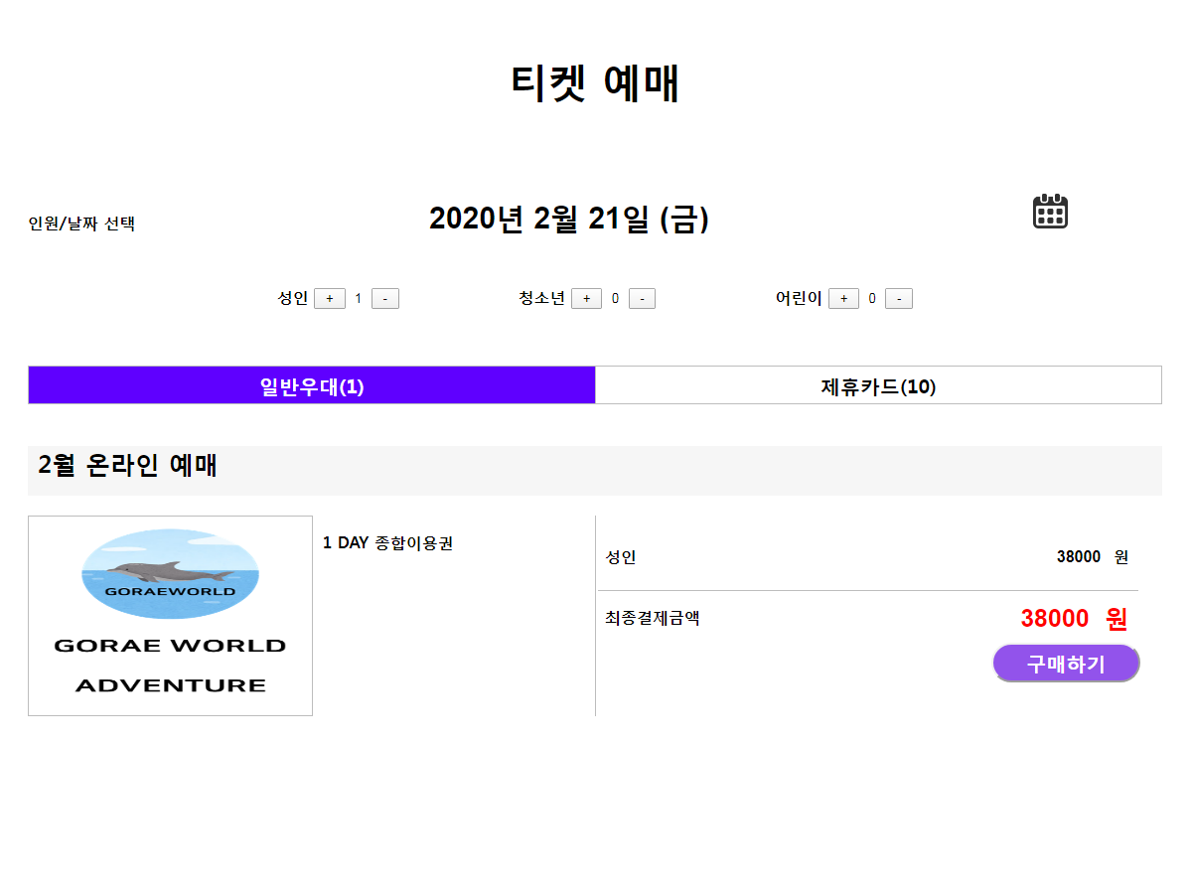
<body>
<input type="text" id="alternate">
<input type="text" id="datepicker" style=“display:none”>
</body>
<script>
$( function() {
$( "#datepicker" ).datepicker({
showOtherMonths: true,
showOn: "button", // 텍스트 박스 옆 달력 표시
buttonImageOnly: true, // 이미지타입
buttonImage: "/이미지경로/",
minDate: 0,
maxDate: "+1M +20D“ // 선택가능날짜
altField: "#alternate",
altFormat: "yy'년' MM d'일' '('D')'“ // alt 날짜형식
});
} );
</script>

Slide 13

var sell_price;
var amount;
function init () {
sell_price = document.form.sell_price.value;
amount = document.form.amount.value;
document.form.sum.value = sell_price;
document.form.tot.value = sell_price;
change();
}
function add () {
hm = document.form.amount;
sum = document.form.sum;
tot = document.form.tot;
hm.value ++ ;
sum.value = parseInt(hm.value) * sell_price;
tot.value = parseInt(hm.value) * sell_price;
}
function del () {
hm = document.form.amount;
sum = document.form.sum;
tot = document.form.tot;
if (hm.value > 1) {
hm.value -- ;
sum.value = parseInt(hm.value) * sell_price;
tot.value = parseInt(hm.value) * sell_price;}
}
function change () {
hm = document.form.amount;
sum = document.form.sum;
tot = document.form.tot;
if (hm.value < 0) {
hm.value = 0;}
sum.value = parseInt(hm.value) * sell_price;
tot.value = parseInt(hm.value) * sell_price;}

Slide 14
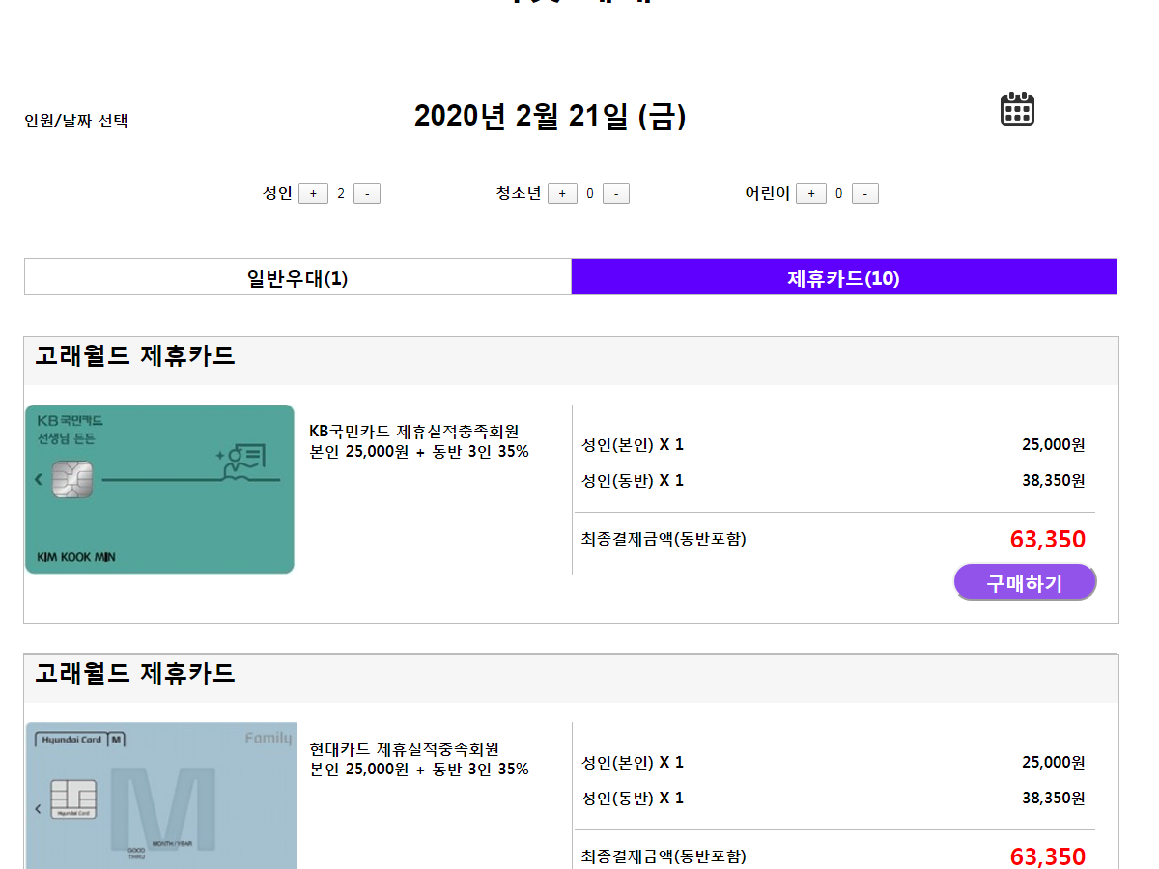
function day(){
var divDay = document.querySelector(".divDay");
var divAnnual = document.querySelector(".divAnnual");
var day = document.querySelector("#day");
var annual = document.querySelector("#annual");
divDay.style.display="block";
divAnnual.style.display="none";
day.style.backgroundColor="#5F00FF";
day.style.color="white";
annual.style.backgroundColor="white";
annual.style.color="black";
}
function anuual(){
var divDay = document.querySelector(".divDay");
var divAnnual = document.querySelector(".divAnnual");
var day = document.querySelector("#day");
var annual = document.querySelector("#annual");
divDay.style.display="none";
divAnnual.style.display="block";
annual.style.backgroundColor="#5F00FF";
annual.style.color="white";
day.style.backgroundColor="white";
day.style.color="black";
}

